Slide 1
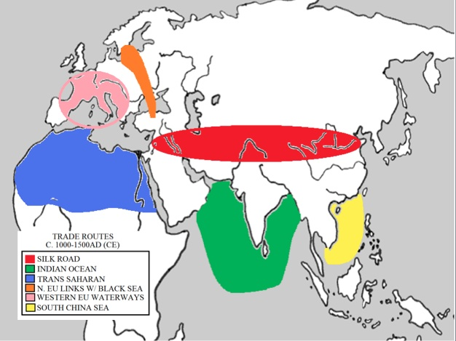

Slide 2
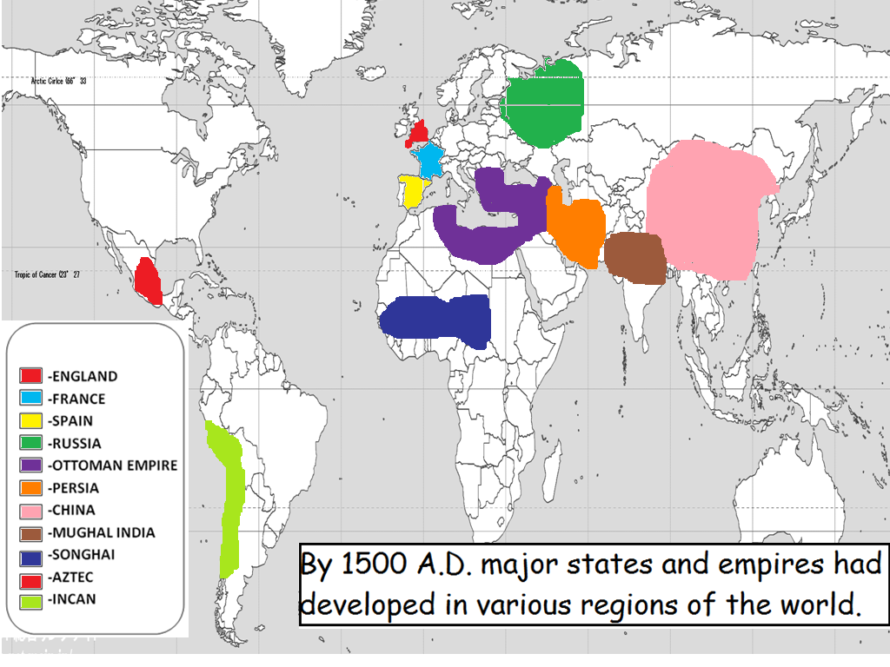
By 1500 CE major states and empires had developed in various regions of the world…

